Slide 1


Steven L. Stolze
5 December 2022

Slide 2

Outline
Executive Summary
Introduction
Methodology
Results
Conclusion
Appendix

Slide 3
Executive Summary
Summary of methodologies
Data Collection
API
Web Scraping
Data Wrangling
Exploratory Data Analysis
SQL
Data Visualization
Interactive Visual Analitcs through Folium Dashboard
Machine Learning Predictions
Summary of all results
Data Analysis
Predictive Analytics

Slide 4
Introduction
Project background and context
By introducing the ability to reuse the first stage booster, SpaceX has shown to be a more cost-effective means of rocket launches by utilizing the Falcon 9 and reducing the cost to nearly 1/3 of the competitions saving customers over 100 million dollars per launch. SpaceY is at the heels of SpaceX in similar feats, so if we are able to conclude the price of each one of our launches, we can compete more effectively. By utilizing machine learning models, we can determine the likelihood of SpaceX being able to reuse the first stage.
Problems you want to find answers
Determinants of first stage landing success
What the determinant conditions need to be for a success

Slide 5

Section 1

Slide 6
Methodology
Executive Summary
Data collection methodology:
Perform data wrangling
Perform exploratory data analysis (EDA) using visualization and SQL
Perform interactive visual analytics using Folium and Plotly Dash
Perform predictive analysis using classification models
How to build, tune, evaluate classification models

Slide 7
Data Collection
The SpaceX API was utilized with the get request and decoded as a Json so we can convert the data into a pandas data frame. Missing values were normalized, and the data was cleaned.
BeautifulSoup was utilized through web scraping of Falcon 9 launch records from Wikipedia so we could convert from HTML to a pandas data frame.

Slide 8
Data Collection
We’ve gathered information from both the SpaceX REST API and Wikipedia.
For the REST API, we extract it and as a .JSON file ands normalize the data into a .csv file.
For the Wikipedia data, we web scrape utilizing HTML and extract it using Beautiful Soup to normalize it as a .csv file.
From there we take both sets and consolidate it for data wrangling.
https://github.com/slstolze/DS_Space_Race_Capstone.git
Use SpaceX REST API
Get HTML data from Wikipedia
Returns SpaceX data as .JSON
Extract using Beautiful Soup
Normalize data to csv
Normalize data to csv
Data prepared for consolidation and wrangling

Slide 9
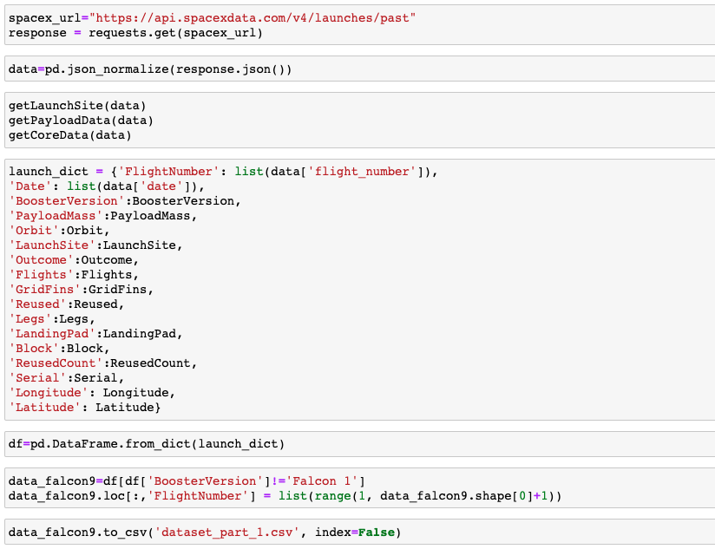
Data Collection – SpaceX API
1. Get Response from API
2. Assign response as Object and convert to .JSON file
3. Clean data
4. Assign list to dictionary
5. Assign dictionary to data frame
6. Filter data frame
7. save data fame to .CSV
https://github.com/slstolze/DS_Space_Race_Capstone.git
1
2
3
4
5
6
7

Slide 10
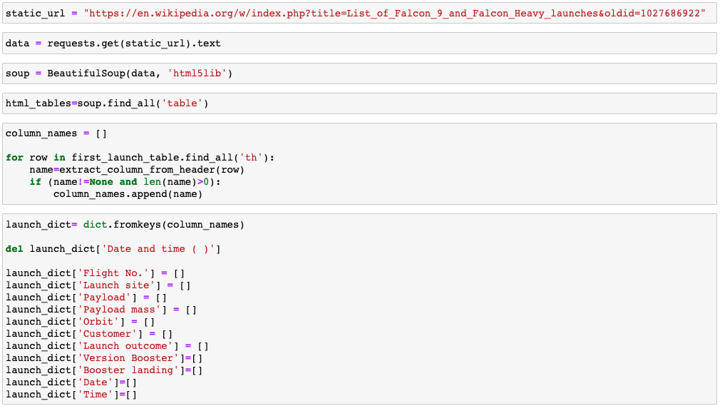
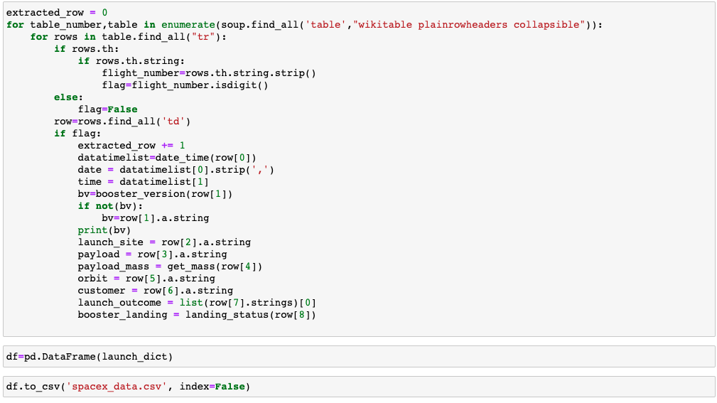
Data Collection - Scraping
1. Get Response from HTML
2. Assign response as Object
3. Create Beautiful Soup Object
4. Find Tables
5. Get column names
6. Create dictionary
7. Add data to keys
8. Convert dict to dataframe
9. DF to .CSV
https://github.com/slstolze/DS_Space_Race_Capstone.git
1
2
3
4
5
6
7
8
9

Slide 11
Data Wrangling
Check null values
Find number/occurrence for mission outcome of each orbit type
Find number of launches for each site
Produce landing outcome label from outcome column
Find number/occurrence for each orbit type
Determine success rate
https://github.com/slstolze/DS_Space_Race_Capstone.git

Slide 12
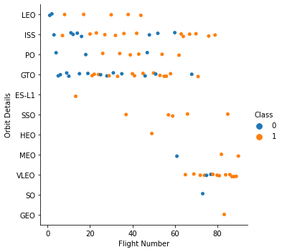
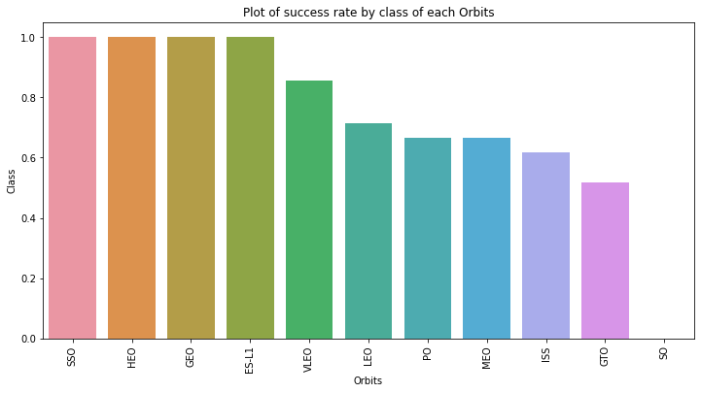
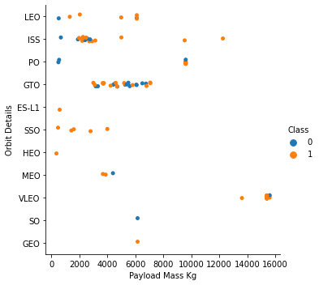
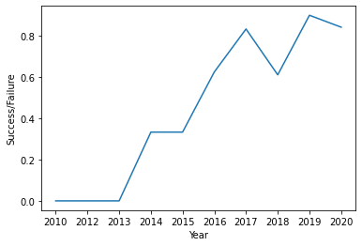
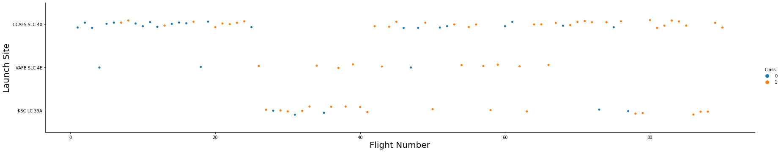
EDA with Data Visualization
We explore the patterns between
launch site/flight number,
launch site/payload
Orbit type/Payload
Orbit type/Flight Number
We see the success rates by each class of orbit type and the success trend from 2010 to 2020.
https://github.com/slstolze/DS_Space_Race_Capstone.git

Slide 13
EDA with SQL
The SQL queries we performed were:
Names of launch sites
Displaying 5 records where launch sites begin with “CCA”
Total Payload Mass carried by boosters launched by NASA
Average payload mass carried by booster version F9 v1.1
First successful landing date
Names of the boosters with success in drone ship w/payload >4K but <6K lbs.
Total # of successful and failure mission outcomes.
Names of the booster versions that had the max payload mass
List of records that display Month, failure, booster version, launch site in 2015
Rank the count of successful landing outcomes form 04/06/2010-20/03/2017
https://github.com/slstolze/DS_Space_Race_Capstone.git

Slide 14
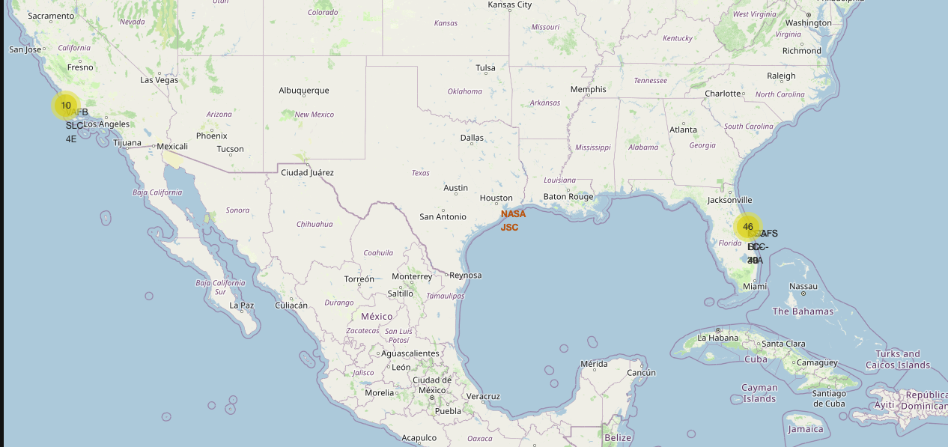
Build an Interactive Map with Folium
Summarize what map objects such as markers, circles, lines, etc. you created and added to a folium map
We marked all launch sites on a map with circles denoting success/failed launches for each site for quick visualization.
We then used marker clusters for high success rates.
Finally we determined the distance between launch sites
This is to determine if there are any correlations with logistics of location.
https://github.com/slstolze/DS_Space_Race_Capstone.git

Slide 15
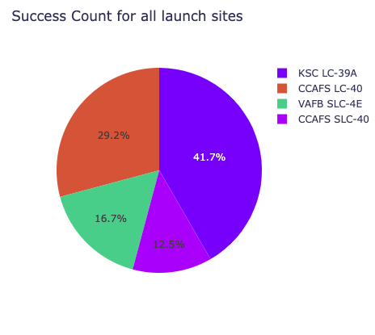
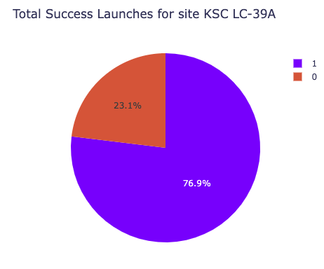
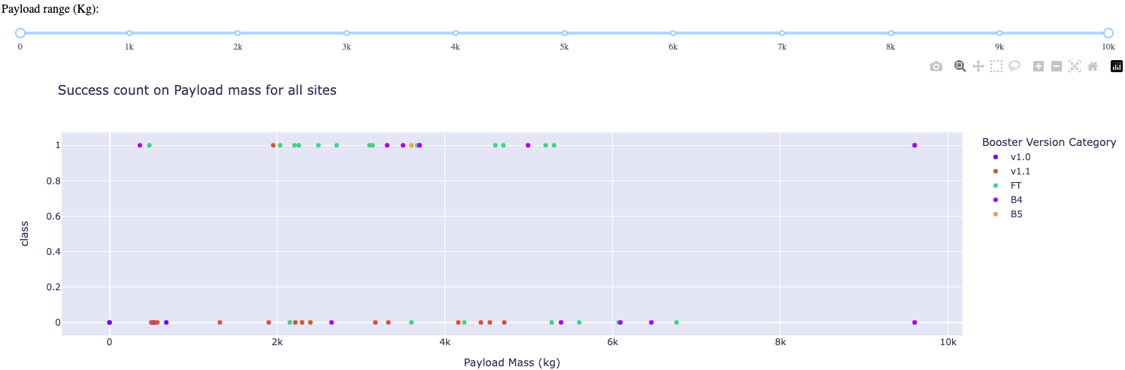
Build a Dashboard with Plotly Dash
Plotly dash was used to build an interactive dashboard
Pie charts with launch totals by sites
Determine the site with the highest success count
Scatter graph between success vs. payload mass.
Determine the payload mass with the highest success rate/booster version
https://github.com/slstolze/DS_Space_Race_Capstone.git

Slide 16
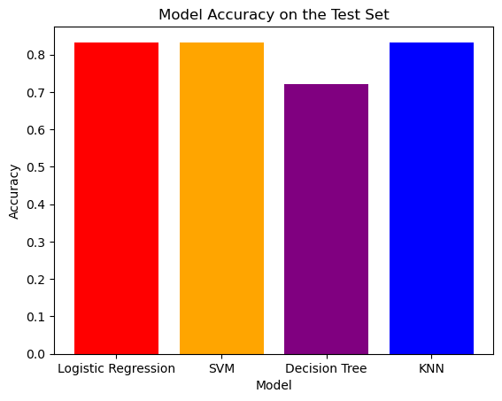
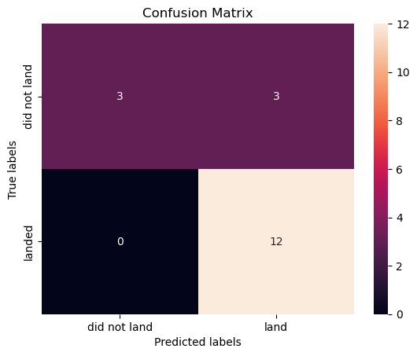

Predictive Analysis (Classification)
The Logistic Regression, SVM and KNN all had the simmilar accuracy with 83.3% with the Decision Tree having the lowest with 72.2%
https://github.com/slstolze/DS_Space_Race_Capstone.git

Slide 17
Results
The Logistic Regression, KNN, and SVM models had the best accuracy with the Decision Tree coming in slightly lower.
Payloads with lower weights performed better
KSC LC 39A had the most successful launces
Orbit GEO, HEO, SSEO, ES L1 had the best success rate.

Slide 18

Section 2

Slide 19
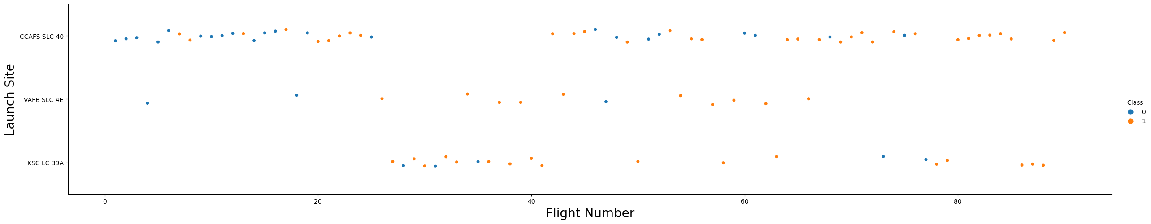
Flight Number vs. Launch Site
The launches from CCAFS SLC 40 shows a higher flight number than other sites

Slide 20
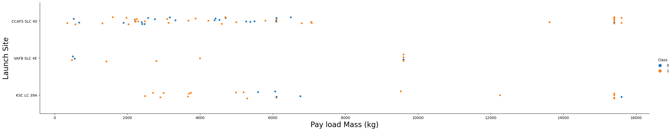
Payload vs. Launch Site
Pay loads with a lower mass mostly come from CCAFS SLC 40.

Slide 21
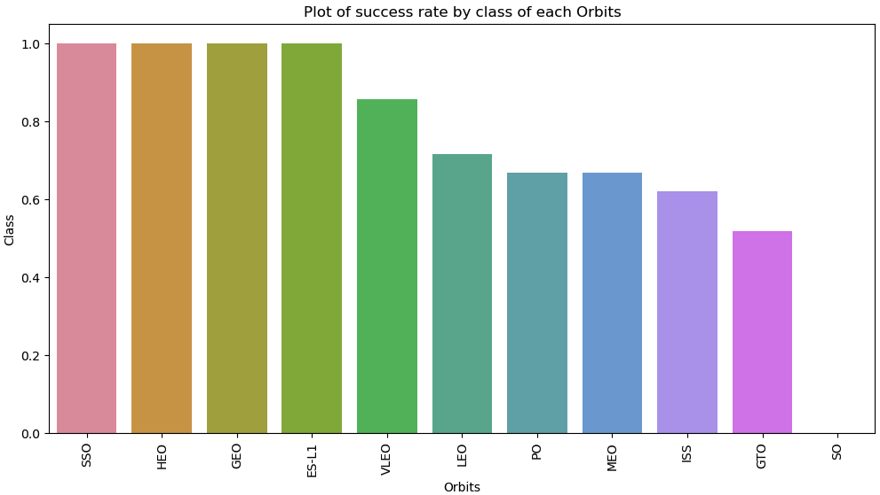
Success Rate vs. Orbit Type
SSO, HEO, GEO and ES-L1 have the highest success rate.
Show the screenshot of the scatter plot with explanations

Slide 22
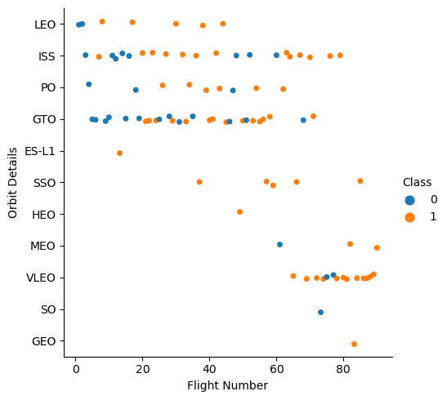
Flight Number vs. Orbit Type
LEO has a relationship with higher success with higher flight numbers.
SSO has the best success rate

Slide 23
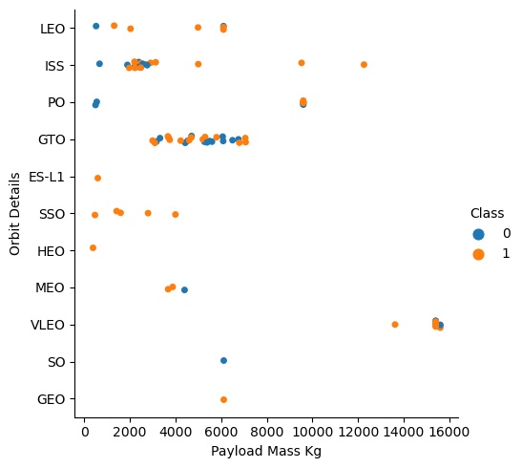
Payload vs. Orbit Type
Heavier payload success is seen with LEO and ISS
Low payload success with SSO and HEO is seen

Slide 24
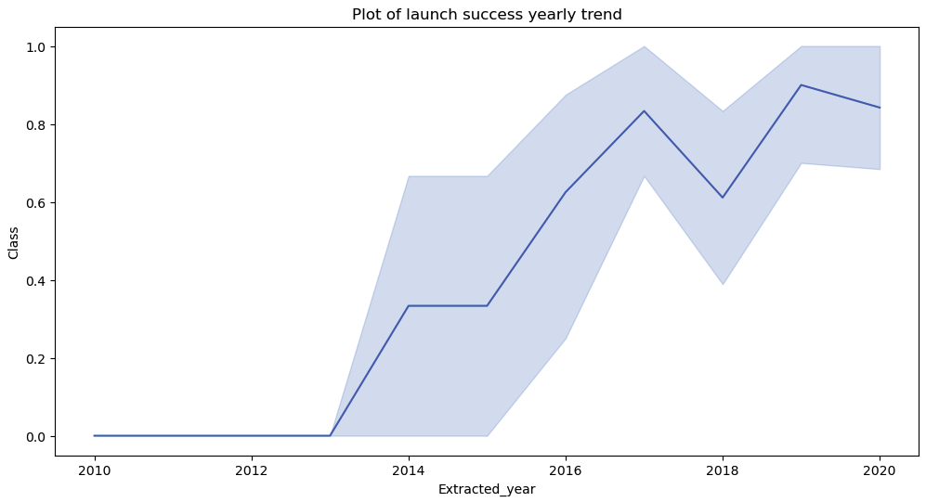
Launch Success Yearly Trend
Success rates have increased since 2013.
The increasing trend has become more stabilized since 2017.

Slide 25
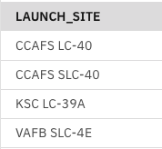
All Launch Site Names
%sql select Unique (LAUNCH_SITE) from SPACEXTBL;

Slide 26
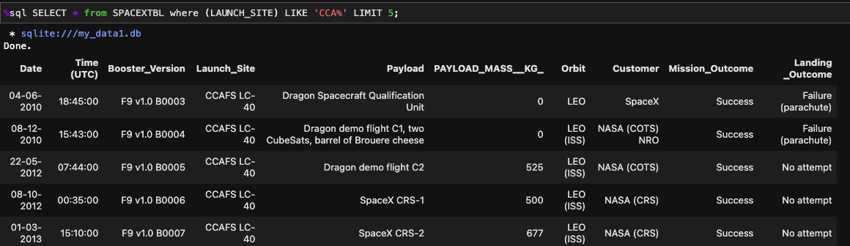
Launch Site Names Begin with 'CCA'
%sql SELECT * from SPACEXTBL where (LAUNCH_SITE) LIKE 'CCA%' LIMIT 5;

Slide 27
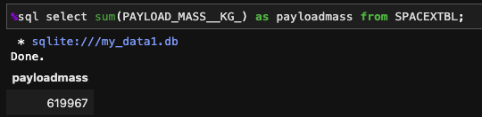
Total Payload Mass
%sql select sum(PAYLOAD_MASS__KG_) as payloadmass from SPACEXTBL;

Slide 28
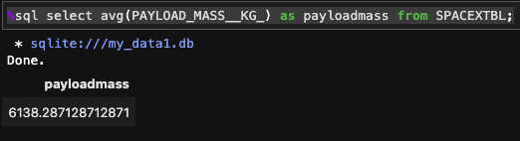
Average Payload Mass by F9 v1.1
%sql select avg(PAYLOAD_MASS__KG_) as payloadmass from SPACEXTBL;

Slide 29
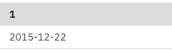
First Successful Ground Landing Date
select min(DATE) from SPACEXTBL Where Landing__Outcome ='Success (ground pad)';

Slide 30
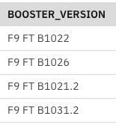
Successful Drone Ship Landing with Payload between 4000 and 6000
%sql select BOOSTER_VERSION from SPACEXTBL where LANDING__OUTCOME='Success (drone ship)' and PAYLOAD_MASS__KG_ BETWEEN 4000 and 6000;

Slide 31
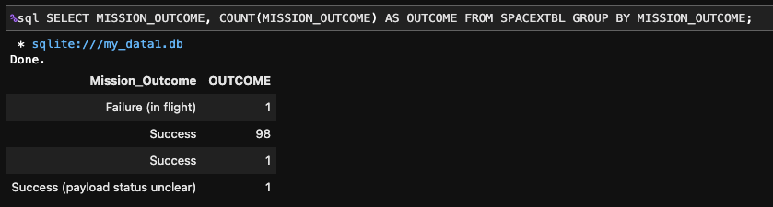
Total Number of Successful and Failure Mission Outcomes
%sql SELECT MISSION_OUTCOME, COUNT(MISSION_OUTCOME) AS OUTCOME FROM SPACEXTBL GROUP BY MISSION_OUTCOME;

Slide 32
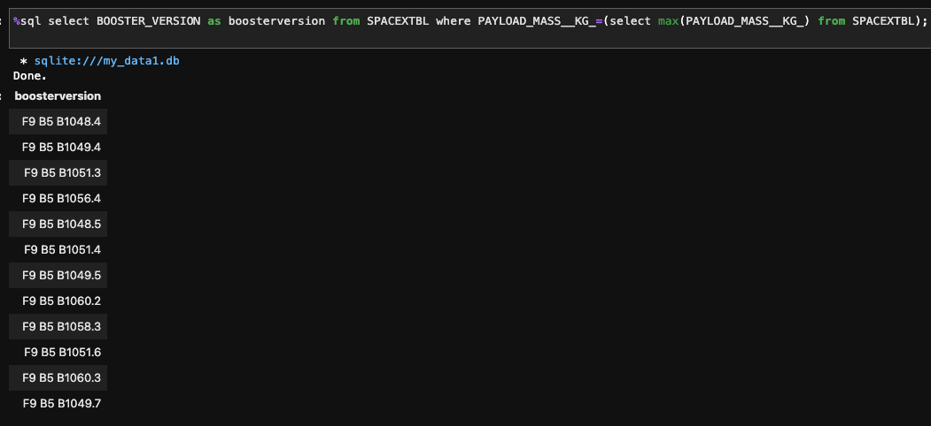
Boosters Carried Maximum Payload
%sql select BOOSTER_VERSION as boosterversion from SPACEXTBL where PAYLOAD_MASS__KG_=(select max(PAYLOAD_MASS__KG_) from SPACEXTBL);

Slide 33
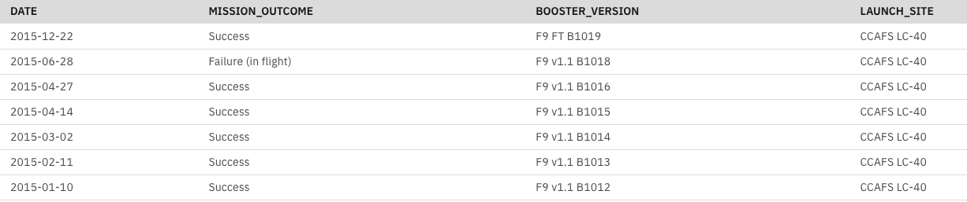
2015 Launch Records
%sql SELECT DATE,MISSION_OUTCOME,BOOSTER_VERSION,LAUNCH_SITE FROM SPACEXTBL where EXTRACT(YEAR FROM DATE)='2015' order by date desc;

Slide 34
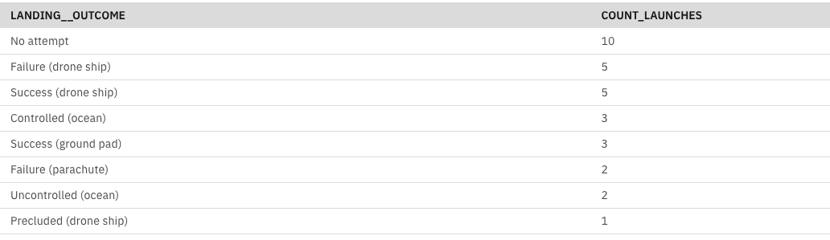
Rank Landing Outcomes Between 2010-06-04 and 2017-03-20
%sql SELECT LANDING__OUTCOME, COUNT(*) AS COUNT_LAUNCHES FROM SPACEXTBL WHERE DATE BETWEEN '2010-06-04' AND '2017-03-20' GROUP BY LANDING__OUTCOME ORDER BY COUNT_LAUNCHES DESC;

Slide 35

Section 3

Slide 36
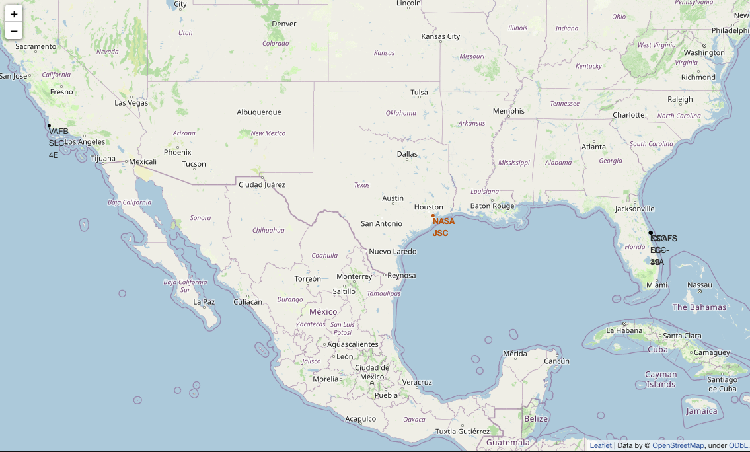
NASA Johnson Space Center and Launch Site Locations
Key locations identified on the folium map
JSC located in TX
Vandanburg AFB located on west coast
Kennedy Space Center/Cape Canaveral AFS on East Coast

Slide 37
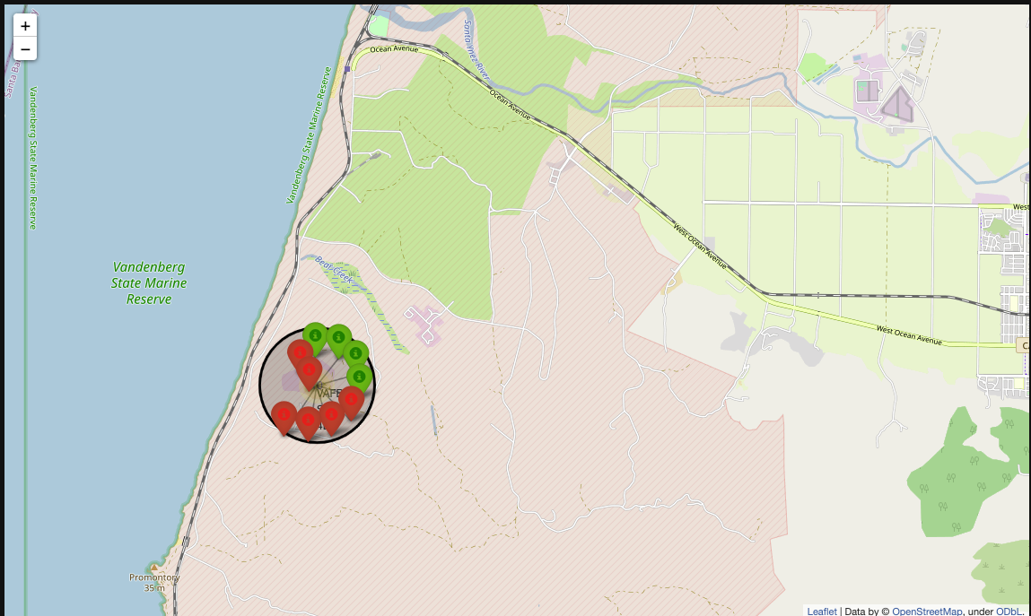
Vandenburg AFB Launch results
Green = Successful Launch
Red = Unsuccessful Launch

Slide 38
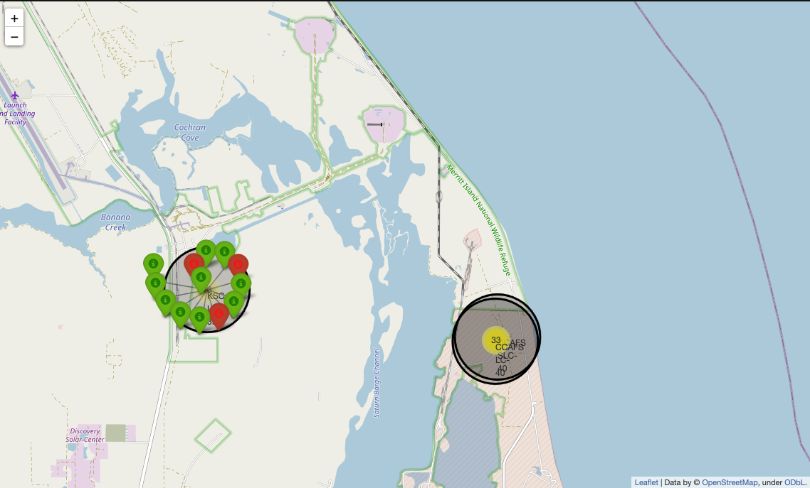
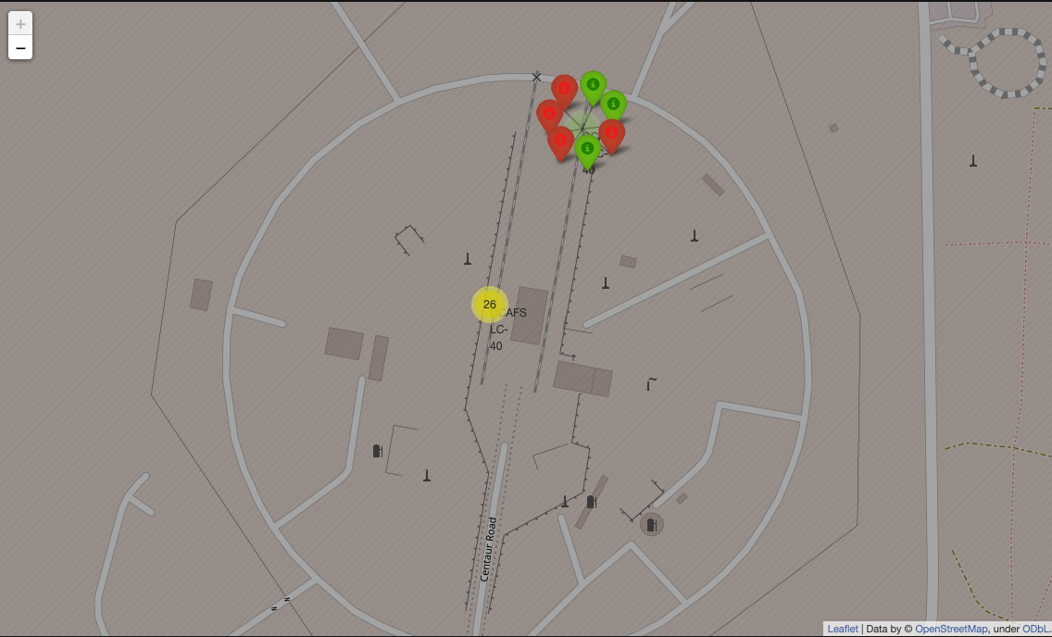
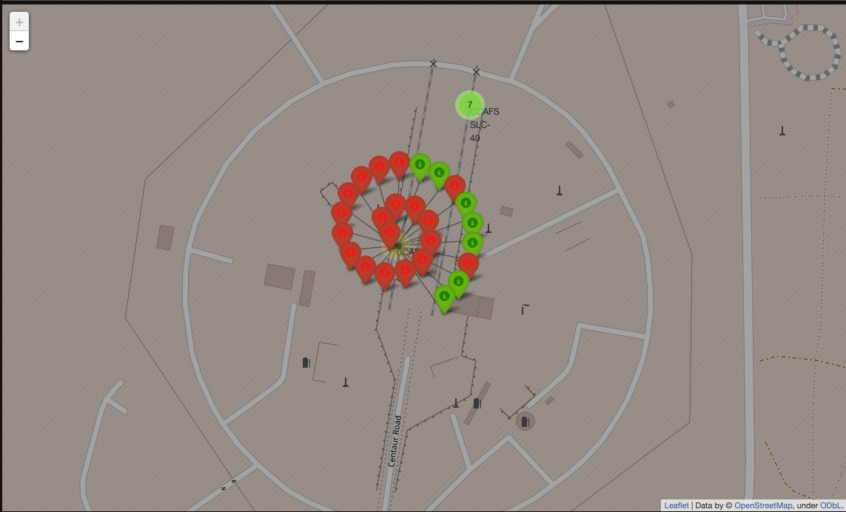
Launch results
Top Left: KSC
Bottom Left/Right: CCAFS
Green = Successful Launch
Red = Unsuccessful Launch

Slide 39
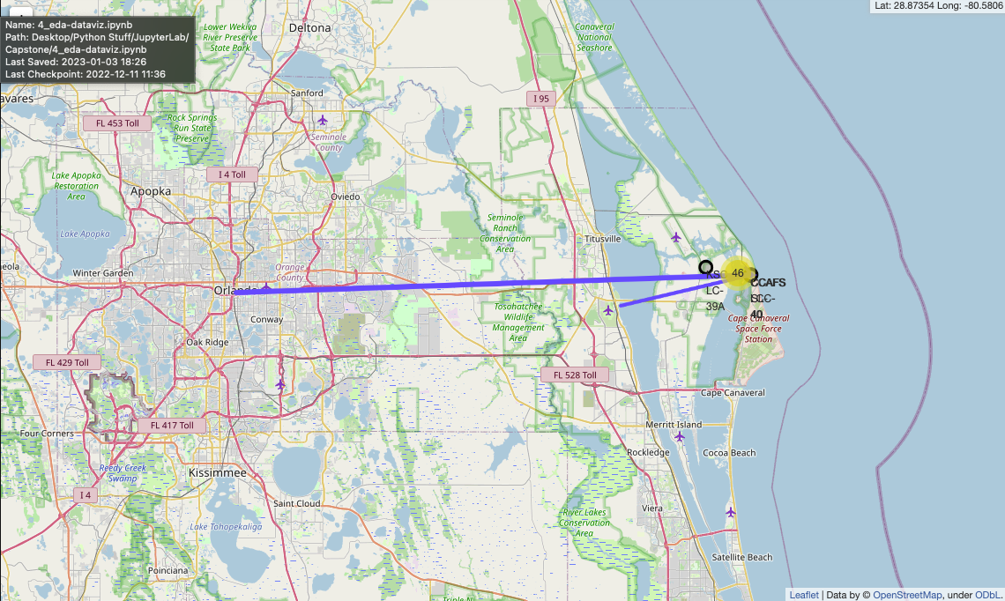
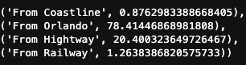
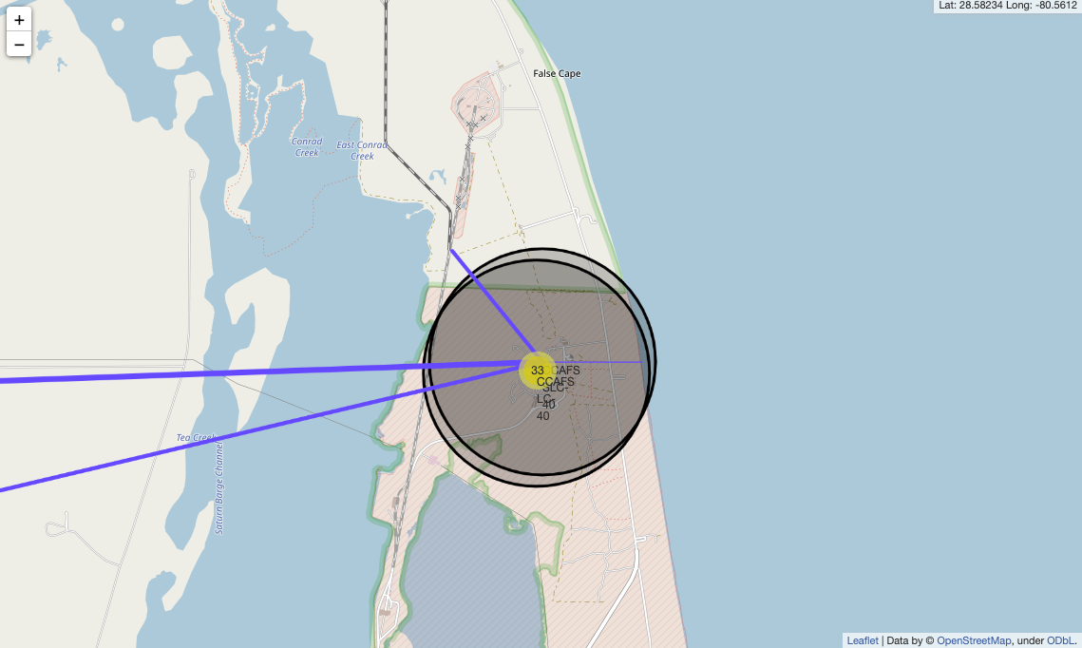
Distance to significant areas from Launch Site CCAFS
Distance in Miles

Slide 40

Section 4

Slide 41
Success rate by launch site
This pie chart highlights the significance in success rates between launch sites

Slide 42
KSC LC-38A
KSC LC-39A had the highest success rate, and it is broken down in this pie chart even further.

Slide 43
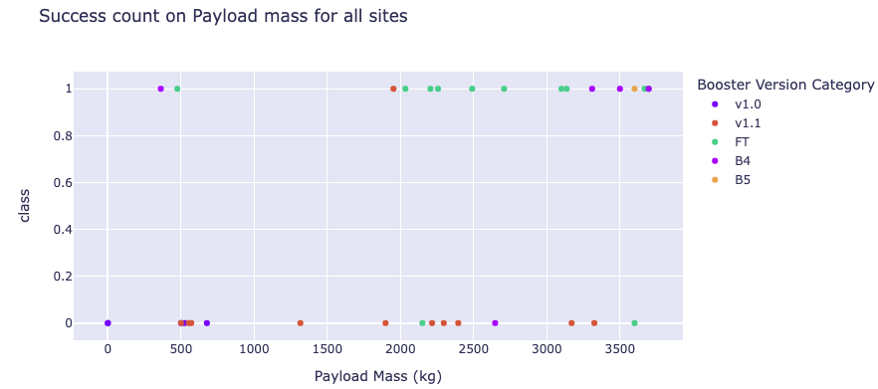
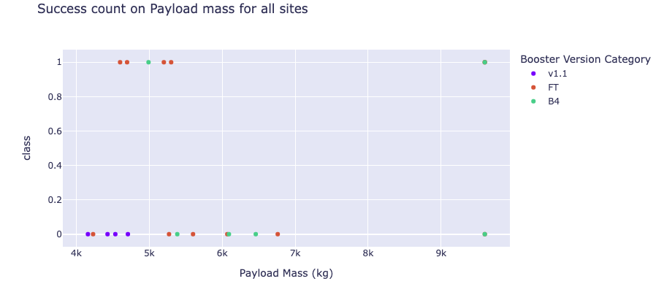
Payload Mass Success by Class
These two charts are the success count per class and by breaking them down between payload weights, we can see that the lower payload weights had a more significant success corilation.

Slide 44

Section 5

Slide 45
Classification Accuracy
The Logistic Regression and SVM had the highest accuracy with 94.4% while the KNN had 88.8% and the Decision Tree had the lowest with 83.3%

Slide 46
Confusion Matrix
We can see that the Logistic Regression, SVM, and KNN can distinguish between the different classes, and that all models have a high false positive. The Decision tree was the most inacurate having higher false negatives.
Log Reg
SVM
Decision Tree
KNN

Slide 47
Conclusions
Orbit GEO, HEO, SSO, ES L1 have the best success rates
Launch success has become more successful since 2017 and the trend could continue upward with further advances
KSC LC 39A had the most successful launches
Low payload mass has a higher success rate than heavier payload masses
The SVM, KNN, and Logistic Regression models seem to do best with accuracy

Slide 48


